Slide 1

SUPERMARKET
PROJECT IN C

Slide 2

Pseudocode
// Display a welcome message for the HBK Superstore Display "Welcome to the HBK Superstore!"
// Ask the user if they are an admin or a customer Display "Are you:" Display "1. Admin" Display "2. Customer" Input userChoice
// If the user is an admin if userChoice is 1 // Call the admin panel function Call adminpanel()
// If the user is a customer else // Initialize variables for each category's total totalFashion = 0 totalHomeAppliance = 0 totalElectronics = 0 totalToysAndGames = 0 totalBooks = 0 totalFoodCorner = 0
// Repeat until the customer decides to check out
Repeat until customer decides to check out
// Display categories
Display "Choose category:"
Display "1. Fashion"
Display "2. Home Appliances"
Display "3. Electronics"
Display "4. Toys and Games"
Display "5. Books"
Display "6. Food Corner"
Display "0. Check Out"
Input categoryChoice
// Process customer's choice based on category
switch categoryChoice
case 1: totalFashion += fashion()
case 2: totalHomeAppliance += homeappliance()
case 3: totalElectronics += electronic()
case 4: totalToysAndGames += toygame()
case 5: totalBooks += book()
case 6: totalFoodCorner += food()
case 0: Display "Check Out"
// Calculate the grand total
grandTotal = grandtotal(totalFashion, totalHomeAppliance, totalElectronics, totalToysAndGames, totalBooks, totalFoodCorner)
// Display order summary and ask for confirmation
confirmation(orderNumber, cashierName, customerName, totalFashion, totalHomeAppliance, totalElectronics, totalToysAndGames, totalBooks, totalFoodCorner)
// End of program

Slide 3
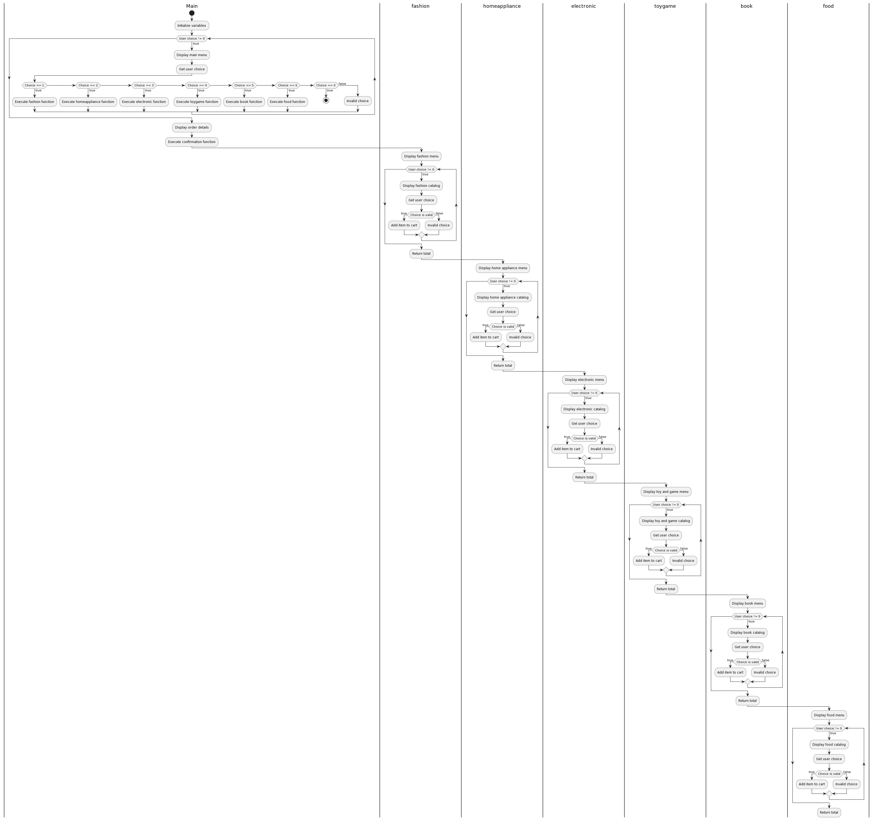
Cybersecurity in the Workplace

Slide 4

Thank you

